Slide 1


Bring Your Experts in Strategically
Business solutions on reducing wine expert costs for Miami Wine, LLC.
Presenter: Yao Luo

Slide 2

STATE OF THE ART
Produce Wine
Bring Expert
Get Rating
New wine being produced
Bring in expert to rate wine quality
Get a quality rating for each wine
Sales
Advertise
Customer Purchase wine
Use the ratings as ads talking points
Background
Data & Methods
Analytics Result
Solution & Recommendation
Business Value

Slide 3
BUSINESS OBJECTIVE
Ratings
Advertising
Some ratings ended up being fairly low
These ratings are not used for advertising due to low values
Chemical Data
Cost of Experts
Can wine ratings be predicted by their chemical features?
Money has already been spent on bringing these experts in
Background
Data & Methods
Analytics Result
Solution & Recommendation
Business Value

Slide 4



75%
25%
THE DATA WE USED
Sulphates
Density
Total Sulfur Dioxide
PH
Free Sulfur Dioxide
White Wine
Alcohol
Quality
Chemical Variables
Red Wine
Fixed Acidity
Chlorides
Wine_Type
Residual Sugar
“Wine_Type” Variable
Volatile Acidity
Citric Acid
Background
Data & Methods
Analytics Result
Solution & Recommendation
Business Value

Slide 5
MODEL BUILDING PROCESS
STEP 1
STEP 2
STEP 3
STEP 4
Split Dataset
Full Model
Improving
Final Model
Final dataset was split into training and validation
Full regression model built on all variables
Model was improved from both directions
Final stepwise model was created
Background
Data & Methods
Analytics Result
Solution & Recommendation
Business Value

Slide 6
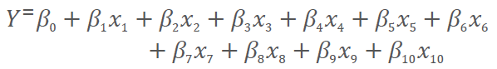
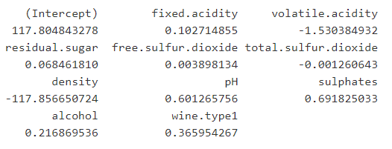
ANALYTICS RESULT
Adjusted R2: 0.2977
R2
29.77% of variation explained by the model
RMSE
Where the following are values from 𝛽0 to 𝛽10 and from 𝑥1 to 𝑥10
RMSE on Training: 0.7334
RMSE on Validation: 0.7319
Overfit
Standard Deviation of Unexplained Variance, Measurement of error
No Signs of Overfitting
Both R2s and RMSEs are very close to each other
Background
Data & Methods
Analytics Result
Solution & Recommendation
Business Value

Slide 7
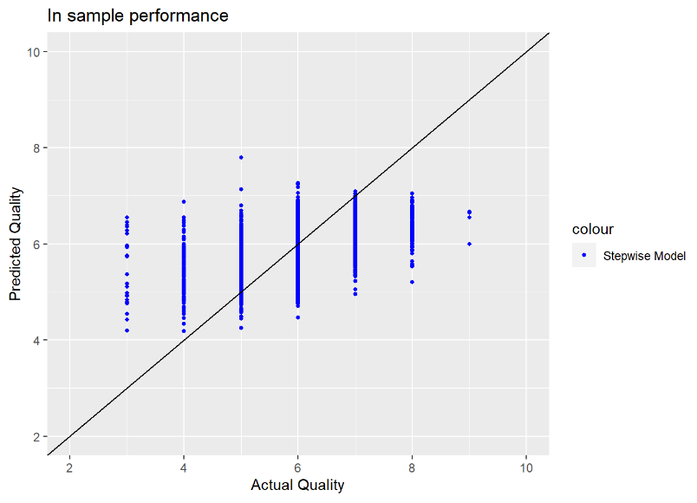
MODEL LIMITATION
0%
29.77%
State of the Art
Current Model
Background
Data & Methods
Analytics Result
Solution & Recommendation
Business Value

Slide 8
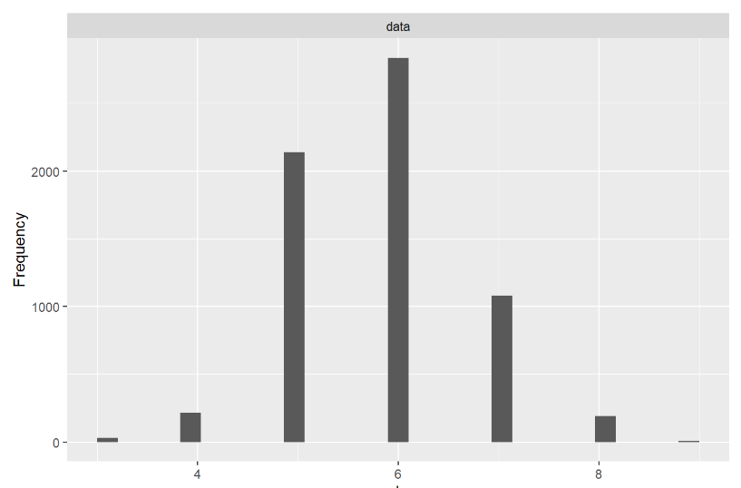
LIMITATION IN DATA
1
Recommendation
Get more data on very low/high quality wines and use them for training the model
Background
Data & Methods
Analytics Result
Solution & Recommendation
Business Value

Slide 9
LIMITATION IN
BUSINESS PROCESS
2
Recommendation
The wine rating process itself may be very subjective
Subjectiveness
Consult an expert and search for insight on what other factors impact wine ratings
Might be missing other factors that impact wine ratings
Other Factors
Background
Data & Methods
Analytics Result
Solution & Recommendation
Business Value

Slide 10
MODEL IMPLEMENTATION
Effective Use
The model can be effectively used by creating a threshold based on the business requirements
Current Model
Current Model is not very accurate in predicting
Business Goal
Our final business goal is to reduce the amount of wine to be rated by an expert for cost saving purposes
29.77%
Current Model
Background
Data & Methods
Analytics Result
Solution & Recommendation
Business Value

Slide 11
MODEL IMPLEMENTATION
Predicted Rating:
4.8 or Below
Actual Rating:
6 or Below
This is the threshold
29.77%
Current Model
Not Bring in an Expert
Background
Data & Methods
Analytics Result
Solution & Recommendation
Business Value

Slide 12
MODEL IMPLEMENTATION
4.8
100%*
29.77%
Using Threshold
Current Model
* This accuracy changes based on the threshold and business requirements
Background
Data & Methods
Analytics Result
Solution & Recommendation
Business Value

Slide 13
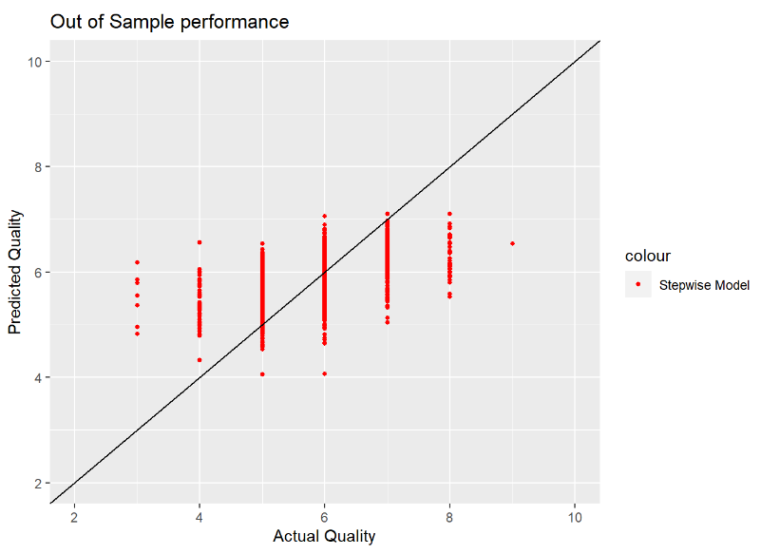
MODEL IMPLEMENTATION
4.8
100%*
29.77%
Using Threshold
Current Model
* This accuracy changes based on the threshold and business requirements
Background
Data & Methods
Analytics Result
Solution & Recommendation
Business Value

Slide 14
BUSINESS VALUE
Improved Model
Set reasonable threshold accordingly based on business requirements
Select WIne
Use model effectively with the threshold and select wine that are does not need to be rated
Reduce Cost
With less wine brought to the expert, cost of expert is reduced successfully
Background
Data & Methods
Analytics Result
Solution & Recommendation
Business Value

Slide 15

REFERENCES
[1] Paulo Cortez, University of Minho, Guimarães, Portugal, http://www3.dsi.uminho.pt/pcortez
[2] A. Cerdeira, F. Almeida, T. Matos and J. Reis, Viticulture Commission of the Vinho Verde Region(CVRVV), Porto, Portugal, 2009
[3] Hadley Wickham, Romain François, Lionel Henry and Kirill Müller (2020). dplyr: A Grammar of Data Manipulation. R package version 1.0.2. https://CRAN.R-project.org/package=dplyr
[4] Boxuan Cui (2020). DataExplorer: Automate Data Exploration and Treatment. R package version 0.8.1. https://CRAN.R-project.org/package=DataExplorer
[5] Venables, W. N. & Ripley, B. D. (2002) Modern Applied Statistics with S. Fourth Edition. Springer, New York. ISBN 0-387-95457-0
[6] Hao Zhu (2019). kableExtra: Construct Complex Table with 'kable' and Pipe Syntax. R package version 1.1.0. https://CRAN.R-project.org/package=kableExtra
[7] Yachen Yan (2016). MLmetrics: Machine Learning Evaluation Metrics. R package version 1.1.1. https://CRAN.R-project.org/package=MLmetrics
[8] Cvrvv. Vinho Verde, www.vinhoverde.pt/en/.

